Slide 1

KCE’s COLLEGE OF ENGINEERING AND MANAGEMENT, JALGAON
Department of Computer Engineering (Polytechnic)
Project Topic
Home Energy Moniter
Group Members Name:
1. Sumit Y Chaudhari (17)
2. Chetan R Chaudhari (32)
3.Pranay V Jagtap(40)
Guide Name: Punam Chaudhari Mam

Slide 2
INTRODUCTION
Electricity consumption is a significant household and business expense. With increasing energy costs, it becomes crucial to monitor and optimize electricity usage to reduce expenses. However, most individuals and businesses lack the necessary tools to analyze their electricity consumption trends, predict future bills, and implement cost-saving measures efficiently.
The Energy Bill Predictor is an innovative desktop application developed using Python and Tkinter, integrating machine learning and AI-based recommendations. The system allows users to input their electricity bill history, predict future costs, analyze appliance usage patterns, and get AI-driven suggestions for energy conservation.
By utilizing Linear Regression from Scikit-learn, the system learns from past energy usage data and predicts the expected electricity bill for the upcoming month. The application also integrates Google Gemini AI-powered chatbot, which provides real-time responses to energy-related queries and power-saving suggestions. The graphical interface, built using Tkinter, ensures an interactive and user-friendly experience for users.

Slide 3
Key Features
Electricity Bill Prediction: Uses machine learning (Linear Regression) to estimate future electricity costs based on past data.
Energy Usage Reports: Analyzes appliance-wise energy consumption and presents data in charts and graphs.
AI Chatbot for Assistance: Provides expert energy-saving recommendations through Google Gemini AI.
User-Friendly GUI: Built with Tkinter, allowing users to navigate easily between sections.
Theme Customization: Supports light and dark themes for an enhanced visual experience.

Slide 4
Problem Statement
Challenges in Managing Electricity Consumption
Many individuals and businesses experience high electricity bills due to unmonitored and inefficient power consumption. Common challenges include:
Lack of tracking mechanisms: Most users do not monitor their electricity usage until they receive their bills.
Unpredictable electricity costs: Fluctuating energy consumption leads to inconsistent billing amounts.
Inefficient appliance usage: Users unknowingly use energy-intensive appliances without realizing their impact on bills.
Need for an Energy Bill Predictor
An automated system that can predict future electricity bills, analyze usage trends, and provide cost-saving recommendations can help users optimize their electricity consumption and reduce their energy expenses.
The Energy Bill Predictor aims to address these challenges by offering data-driven insights and AI-powered assistance for better energy management.

Slide 5
Objectives
The primary goal of this project is to develop a smart energy management system that helps users predict, analyze, and optimize their electricity usage.
Specific Objectives:
Develop a machine learning-based predictive model that can estimate future electricity bills based on past consumption.
Create an interactive graphical interface using Tkinter for seamless user experience.
Provide detailed energy usage reports, helping users understand which appliances contribute the most to their bills.
Integrate an AI chatbot that provides personalized energy-saving recommendations.
Enhance user awareness about electricity conservation and efficient power usage.

Slide 6
Hardware and Software Requirements
Software | Description
Operating System | Windows
Programming Language | Python
Libraries Used | Tkinter, Scikit-learn, NumPy, Pandas, Matplotlib, Google Generative AI
Development Tools | PyCharm
Component | Minimum Requirement | Recommended
Processor | Intel Core i3 | Intel Core i5 or higher
RAM | 4GB | 8GB or higher
Storage | 500MB free space | 1GB free space
Display | 1024x700 resolution | 1920x1080 resolution

Slide 7
Implementation
User Interface (UI) Module
  Provides an interactive Tkinter-based GUI for data input and visualization.
  Includes a navigation bar for easy access to different sections.
  Supports theme customization (light/dark mode).
Data Input & Processing Module
  Users enter their last three months' electricity bills.
  The system calculates the average consumption pattern.
Machine Learning Prediction Module
  Implements Linear Regression (from Scikit-learn) to predict the next month's bill.
  Displays results in graphical charts and numerical values.

Slide 8
4. Energy Usage Analysis Module
  Allows users to add appliances and specify their daily usage hours.
  Generates detailed reports and energy usage trends.
  Identifies power-hungry appliances for cost reduction.
5. AI Chatbot Module
  Integrated with Google Gemini AI to provide automated responses to energy-related queries.
  Offers power-saving recommendations and real-time guidance.

Slide 9
Results
Electricity Bill Prediction
The system predicts future electricity bills using machine learning-based regression models.
Displays bar and line graphs representing electricity bill trends.
Energy Usage Analysis
Lists appliances with respective power consumption.
Provides detailed reports on total energy usage.
Helps users identify high-energy-consuming appliances.
AI Chatbot Integration
The chatbot provides personalized responses to energy-related queries.
Users receive recommendations for energy conservation.

Slide 10
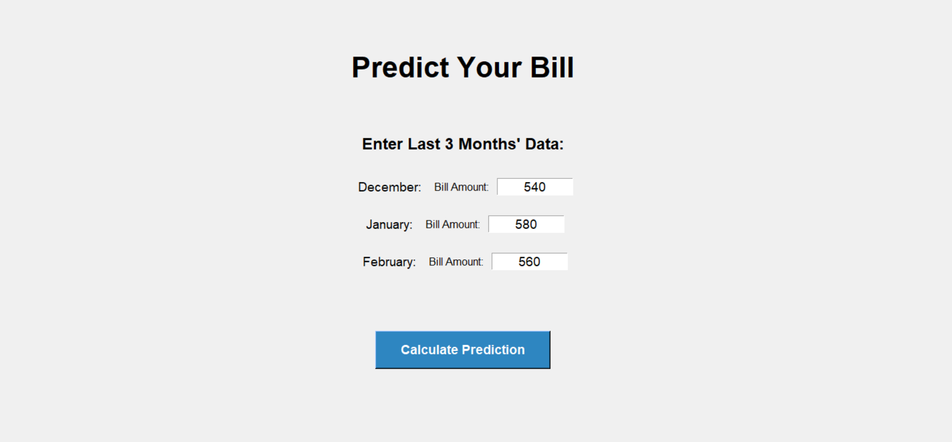
Screenshot of Output :

Slide 11
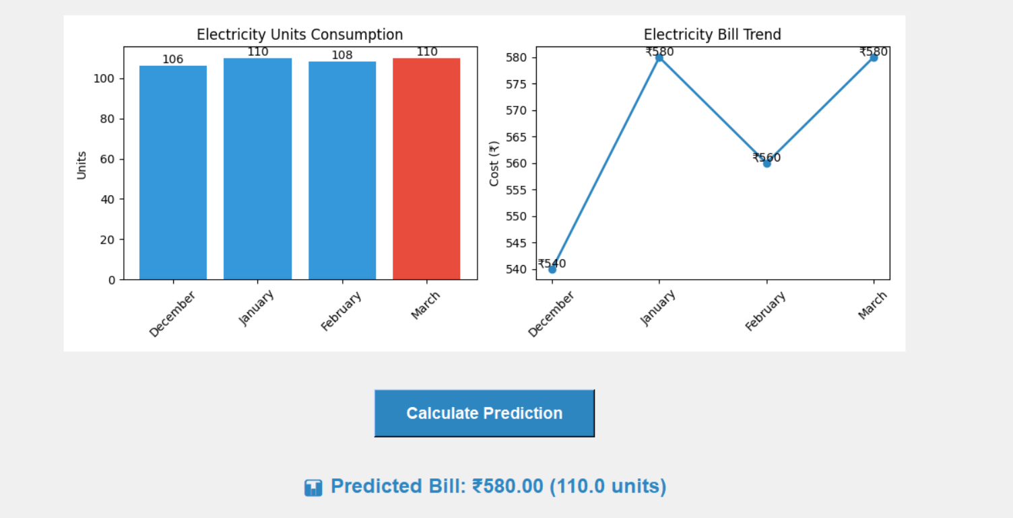

Slide 12
Linear regression in machine learning is a supervised learning technique that models the relationship between a dependent variable (y) and one or more independent variables (x) using a straight line (or hyperplane in multiple dimensions), aiming to predict a continuous numerical value.
Mathematical Equation : Simple Linear Regression (one independent variable) :y = β₀ + β₁x + ε
y : Dependent variable (predicted value)
x : Independent variable (feature)
β₀ : Intercept (predicted value of y when x is 0)
β₁ : Slope (change in y for every unit change in x)
y : Error term (random variation)
Example : Imagine a company wants to predict sales based on advertising spend. They collect data on advertising spend (x) and corresponding sales (y).

Slide 13
Advertising Spend (x) | Sales (y)
1000 | 5000
2000 | 8000
3000 | 12000
4000 | 15000
Using linear regression, they might find the equation: Sales (y) = 2000 + 3 * Advertising Spend (x).
This means for every 1 unit increase in advertising spend, sales are predicted to increase by 3 units.
The intercept (2000) represents the predicted sales when advertising spend is zero.

Slide 14
How it works :
Data Collection : Gather data on the independent and dependent variables.
Model Training : The linear regression model learns the relationship between the variables by finding the "best-fit" line (or hyperplane) that minimizes the difference between the predicted and actual values. Prediction : Once the model is trained, it can be used to predict the value of the dependent variable for a new set of independent variable values.

Slide 15
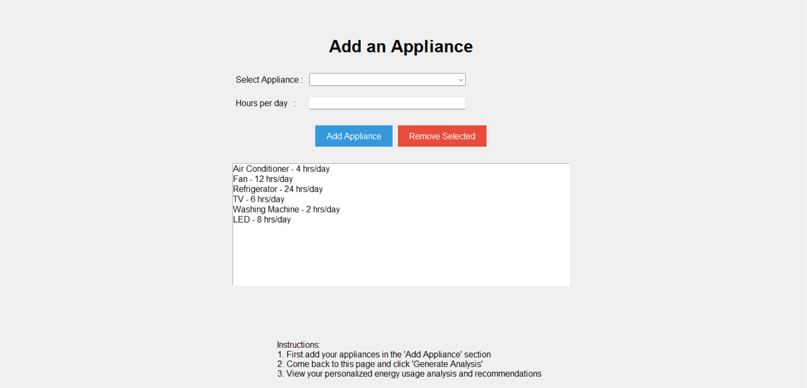

Slide 16
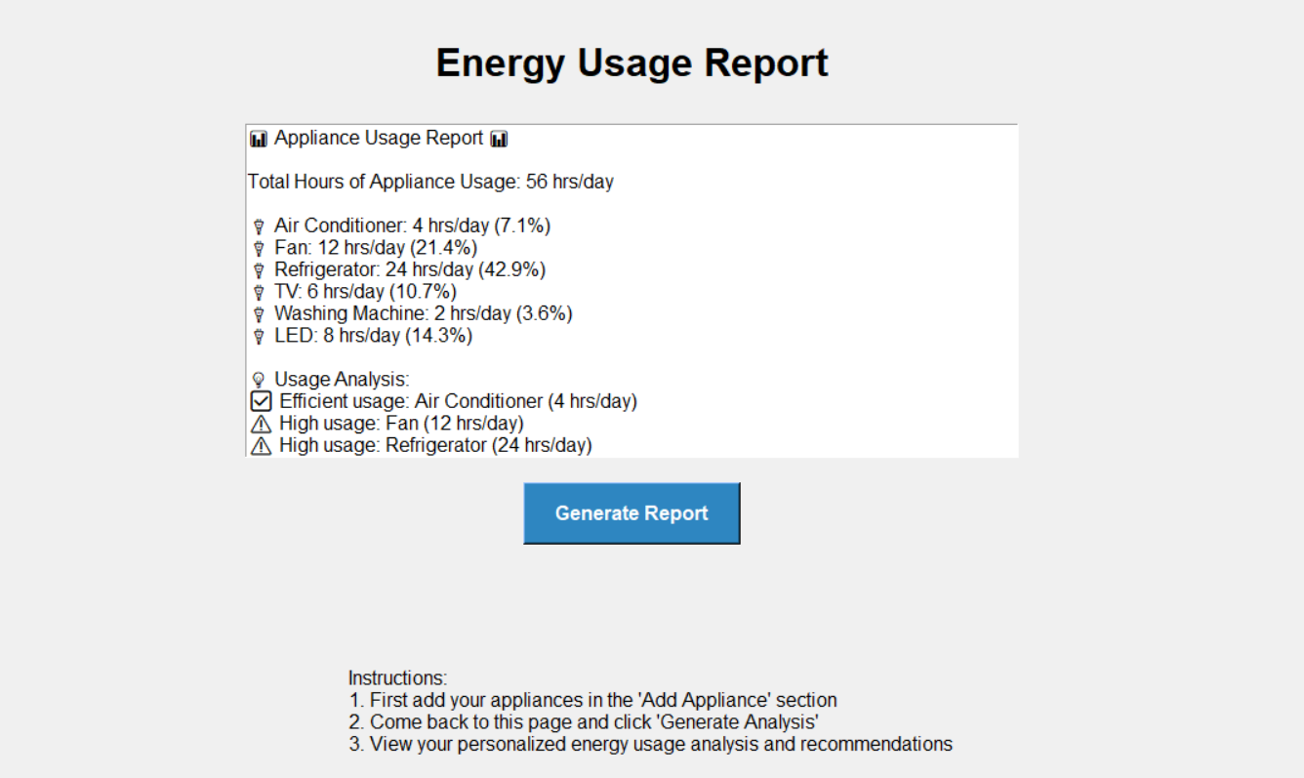

Slide 17
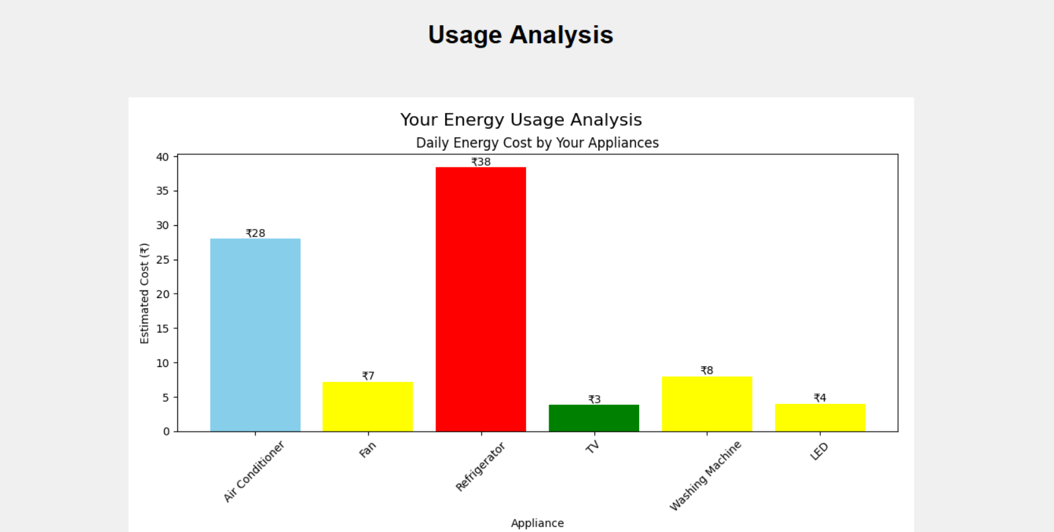

Slide 18
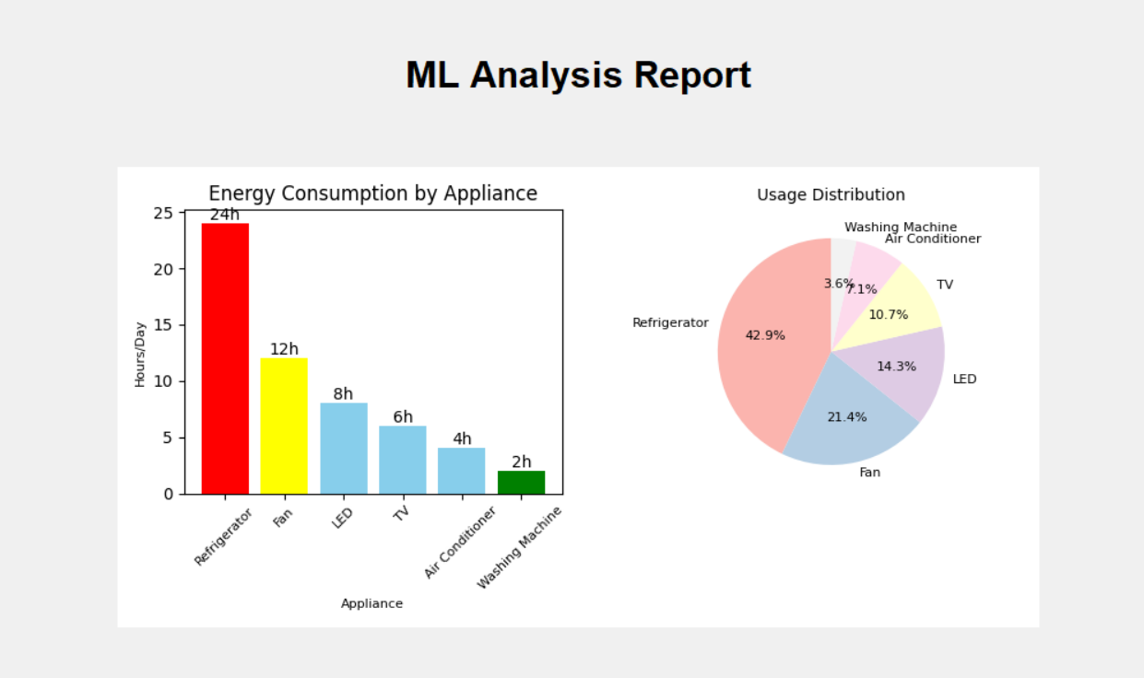

Slide 19
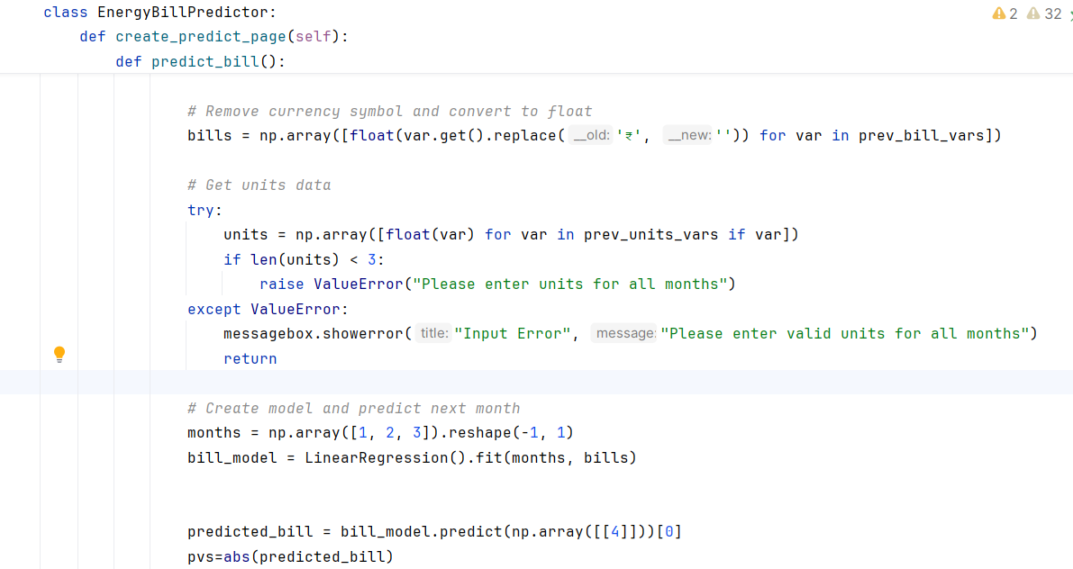
Program Code :

Slide 20
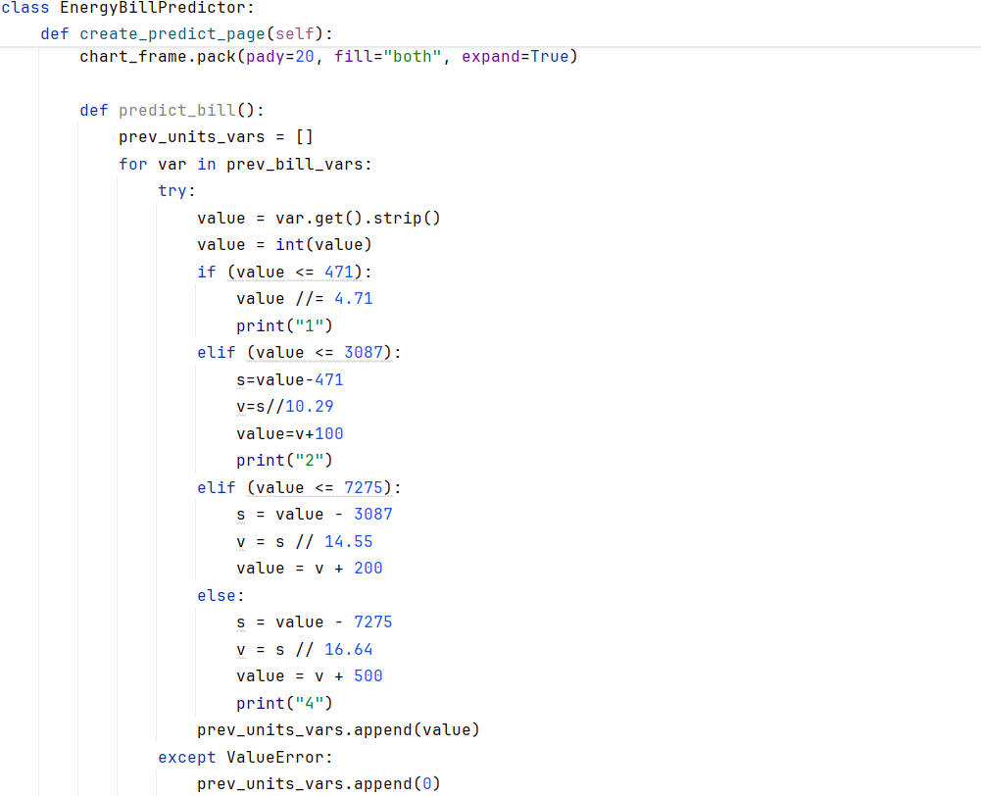

Slide 21
Conclusion
Summary of Achievements
The Energy Bill Predictor successfully estimates future electricity bills, provides insights into power consumption, and offers AI-driven energy-saving recommendations. The system integrates machine learning, interactive UI, and AI-powered chatbot assistance to create a comprehensive energy management solution.\
Benefits of the System
✅ Predicts electricity bills with high accuracy.
✅ Helps users monitor and optimize energy usage.
✅ AI chatbot offers real-time guidance on energy conservation.
✅ User-friendly interface for easy navigation.
✅ Supports graphical analysis for better decision-making.
Future Scope
Integrating real-time electricity tariff updates for enhanced accuracy.
Expanding the dataset to improve machine learning model performance.
Developing a mobile application version for on-the-go bill tracking.

Slide 22
THANK YOU !!!

